Slide 1
RNN
Recurrent Neural Networks

Slide 2
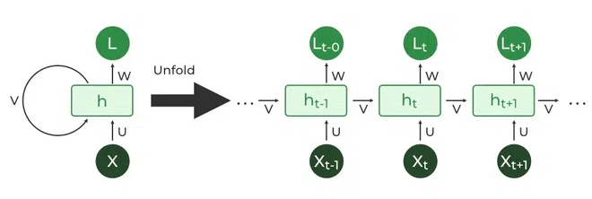
RNN
A Recurrent Neural Network (RNN) is a type of artificial neural network where the output from the previous step is fed as input to the current step.
RNNs process sequences element by element, with each step using both the current input and the state from the previous step (hidden state). This makes them useful for tasks involving time series, natural language processing (NLP), or any other form of sequential data.

Slide 3
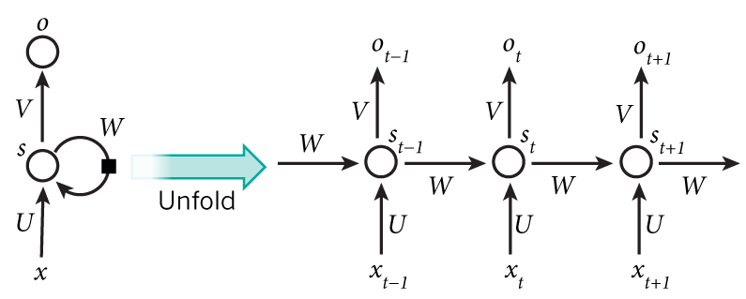
Architecture of an RNN
The basic structure of an RNN involves:
Input layer (x): Takes the input data at each time step.
Hidden layer (s): Maintains a hidden state that gets updated at each time step based on the current input and the previous hidden state.
s_{t} = f(U.x_{t} + W.s_{t-1})
Output layer (o): Produces predictions at each time step.
o_{t}​ = softmax(Vs_{t​})
They accept an input vector x and give you an output vector y. However, crucially this output vector’s contents are influenced not only by the input you just fed in, but also on the entire history of inputs you’ve fed in in the past

Slide 4
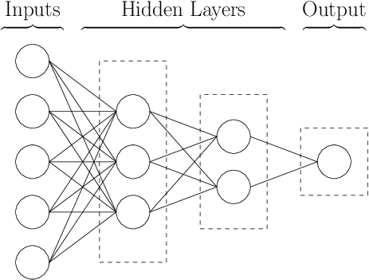
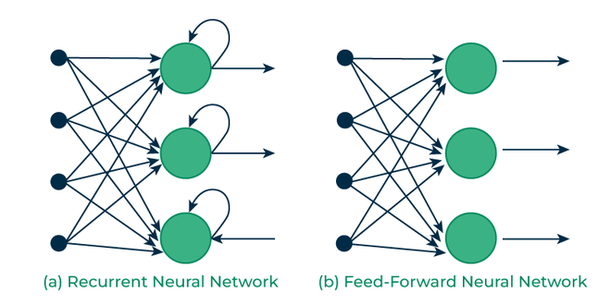
How RNNs differ from Feedforward Neural Networks?
Forward Pass (Info only passed forward)
Backward Error Propagation (to adjust weights)

Slide 5
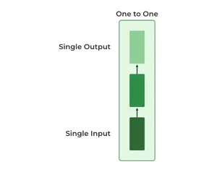
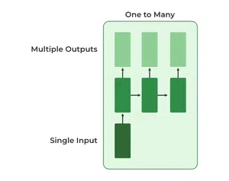
Types of RNNs (with Applications)
One to One
One to MANY
This type of RNN behaves the same as any simple Neural network it is also known as Vanilla Neural Network. In this Neural network, there is only one input and one output.
In this type of RNN, there is one input and many outputs associated with it. One of the most used examples of this network is Image captioning where given an image we predict a sentence having Multiple words.

Slide 6
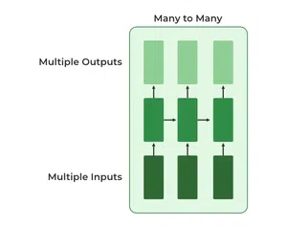
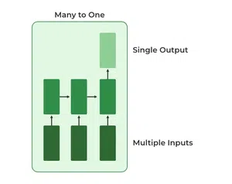
Types of RNNs (with Applications)
MANY to One
MANY to MANY
Many inputs are fed to the network at several states of the network generating only one output. This type of network is used in the problems like sentimental analysis. Where we give multiple words as input and predict only the sentiment of the sentence as output.
There are multiple inputs and multiple outputs corresponding to a problem. In language translation, we provide multiple words from one language as input and predict multiple words from the second language as output.

Slide 7
Training Data: One Hot Encoding
A one-hot vector is filled with 0s except for a 1 at index of the current letter
Example,
all characters: [“a”, “b”, “c”, “d”, “e”]
“a” → [ 1, 0, 0, 0, 0 ]
“b” →[ 0, 1, 0, 0, 0 ]
“c” → [ 0, 0, 1, 0, 0 ]
“d” → [ 0, 0, 0, 1, 0 ]
“e” → [ 0, 0, 0, 0, 1 ]

Slide 8
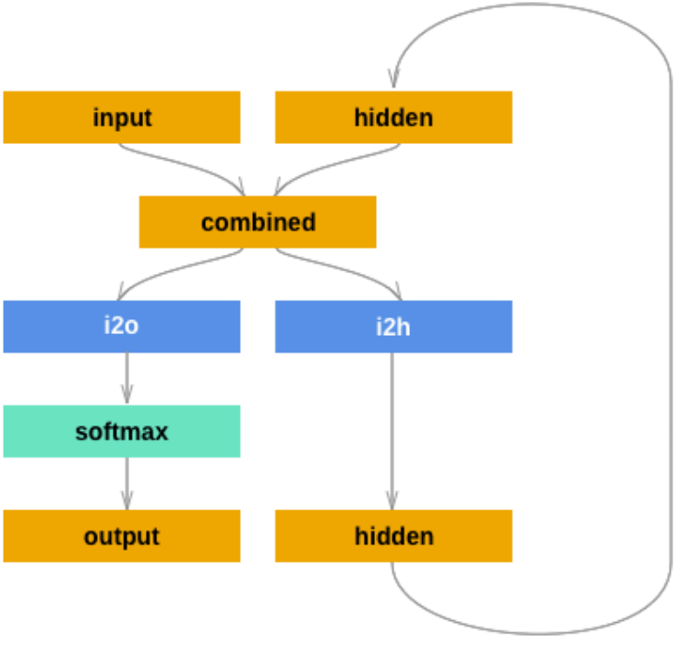
RNN – Name Classification

Slide 9
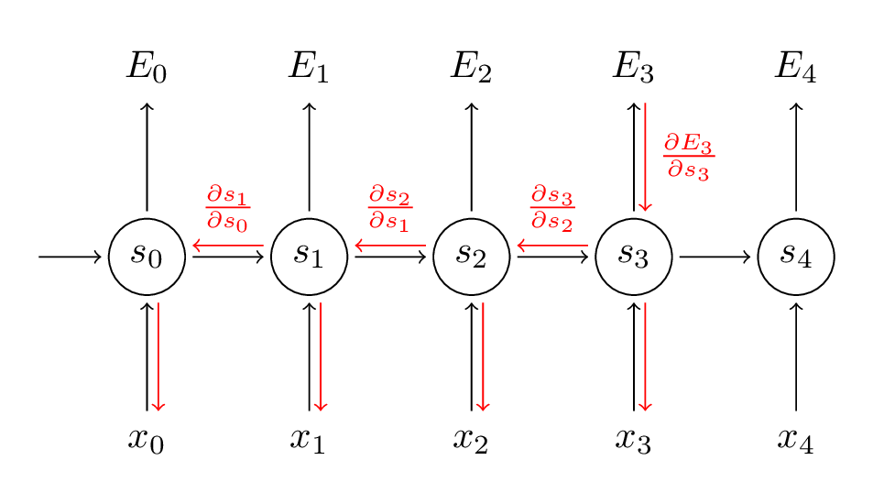
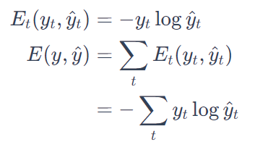
Back Propagation Through Time (BPTT)
Cross Enropy Loss (or, Negative Log Likeliood)
Here, y_{t}​ is the correct word at time step t, and
y^_{​t}​ is our prediction. We typically treat the full sequence (word) as one training example, so the total error is just the sum of the errors at each time step (single letters).
Our goal is to calculate the gradients of the error with respect to our parameters U, V and W and then learn good parameters using Stochastic Gradient Descent. Just like we sum up the errors, we also sum up the gradients at each time step for one training example

Slide 10
Limitations of RNN
Vanishing/exploding gradients: RNNs struggle with learning long-term dependencies due to issues with gradients either becoming too small (vanishing) or too large (exploding) during training.
Solutions: Variants like Long Short-Term Memory (LSTM) networks and Gated Recurrent Units (GRU) were introduced to address these issues and improve the ability of RNNs to capture longer-term dependencies.

